Slide 1
Predicting Effective Arguments
W207 Final Project
Adam, Vivek & Waqas

Slide 2

Problem Motivation: Grading Argumentative Essays
Problem: It is difficult to provide uniform grading of argumentative essays, on-demand and at scale.
The current state-of-the-art can provide writing feedback, but is weak at grading argumentative essays.
Feedback Prize - Predicting Effective Arguments | Kaggle. Kaggle.com. Published 2022. Accessed July 12, 2022. https://www.kaggle.com/competitions/feedback-prize-effectiveness/data
Notes:
The specific act of argumentative essay writing demands skills distinct from narrative or expository writing. Specifically - argumentative writing is a dialogic problem-solving activity between the author and the audience, two groups that may have a difference of opinion about a controversial issue[6]. It requires self-regulation, empathy with the audience’s perspective, knowledge of the topic, and the linguistic skill to provide a coherent whole.
With our project, we are taking on an NLP challenge, the automated grading of argumentative essays written by students in the 6th through 12th grade.
The specific act of argumentative essay writing demands skills distinct from narrative or expository writing. Specifically - argumentative writing is a dialogic problem-solving activity between the author and the audience, two groups that may have a difference of opinion about a controversial issue[6]. It requires self-regulation, empathy with the audience’s perspective, knowledge of the topic, and the linguistic skill to provide a coherent whole.
This Kaggle competition is sponsored by Georgia State University, and is a currently running competition, concluding on August 23.
Let’s look at a specific example, drawn from the training data.

Slide 3
Dataset Description

Slide 4
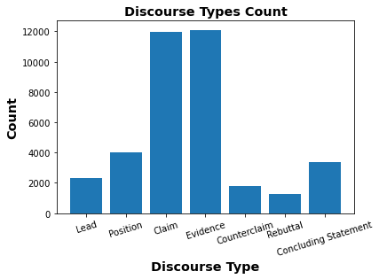
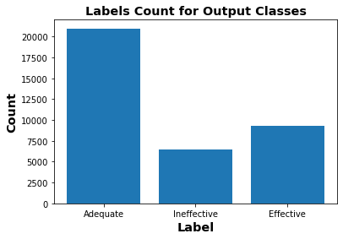
Datasets
Data Source:
The dataset contains 4161 argumentative essays written by U.S students in grades 6-12.
These essays were annotated by expert raters for 7 discourse elements
1) Lead, 2) Position, 3) Claim, 4) Counterclaim, 5) Rebuttal, 6) Evidence & 7) Concluding Statement
36765 discourse texts
Labelling:
Human readers rated each argumentative element, in order of increasing quality, as one of 3 Classes:
1) Ineffective, 2) Adequate & 3) Effective

Slide 5

Inputs and Outputs
Essay: There is no life on Mars
Lead, Adequate
The story is about how NASA took a picture of Mars and a face was seen on the planet. NASA doesn't know if the landform was created by life on Mars, or if it is just a natural landform.
On my perspective, I think that the face is a natural landform because I dont think that there is any life on Mars. In these next few paragraphs, I'll be talking about how I think that is is a natural landform
[...]
Solution Output
Perspective, Ineffective
Discourse ID | Ineffective | Adequate | Effective
a261 | 0.2 | 0.6 | 0.2
5a8b | 0.7 | 0.15 | 0.15
Goal → Predict the effectiveness rating for each discourse element
argumentation_scheme_and_rubrics_kaggle.docx. argumentation_scheme_and_rubrics_kaggle.docx. Google Docs. Published 2022. Accessed July 12, 2022. https://docs.google.com/document/d/1G51Ulb0i-nKCRQSs4p4ujauy4wjAJOae/edit
Notes:
Here we provide an example input drawn from the provided training set, and a mocked up output.
We receive the complete text of the essay, and the labeled discourse elements, e.g. the first paragraph here is labeled ‘Lead’, and the second labeled, ‘Perspective’.
Our training data includes the effectiveness rating, ‘Adequate’ and ‘Ineffective’ shown in bold. These ratings are provided by expert raters guided by a published rubric.
We are tasked with developing a solution to return probability values for each effectiveness rating for each discourse element, and will be evaluated on our log loss result, with our outputs rescaled prior to being scored.
The goal is to return an effectiveness rating for each discourse element. Rating the entire essay is out of scope of this project.

Slide 6
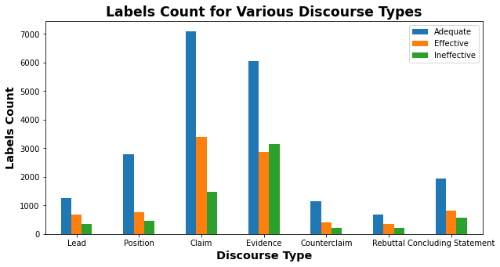
Imbalance Training Data

Slide 7
Approach

Slide 8

Leveraging Expert Knowledge for Feature Selection
Grading Guidance:
The introduction begins with a statistic, a quotation, a description, or some other device to grab the reader’s attention and point toward the thesis.
Classification:
Effective Adequate
Ineffective
Notes:
When faced with identifying features, the qualitative guidance raises questions. What constitutes, “some other device that grabs the reader’s attention”?
What makes a description grab the reader’s attention?
Will the same text equally grab the attention of all graders? To better identify the thought process of expert graders, we authored a questionnaire consisting of labeled essays randomly drawn from the dataset, stratified to represent, at least once, every effectiveness across every discourse element type[4].
We distributed the questionnaire to a number of professional educators with experience teaching at the primary and secondary level, sampled by convenience. Responses were gathered, preserving anonymity, and distributed to the team for review.

Slide 9

Leveraging Expert Knowledge for Feature Selection
Discourse Element | Educator Response
The study the ability of humans to read subatle changes in facial expressions, thast they appiled reverse correlation technique to reveal visual features that mediate understanding of emotion expressed by the face. Suprising finding were that (1) the noise added to test face image had profound effect on the facail expression and (2) in most every istance the new expression was meaningful. [...] | I would suggest the evidence was graded as ineffective because it isn’t in direct support of a claim. Honestly, I don’t see a claim at all. This essay is really difficult to read/follow.
Include feature: Text Perplexity
Notes:
The responses are useful in identifying that if a discourse element is, “really difficult to read/follow,” then a grader may be more likely to rate that element as Ineffective. This insight led to development of the extracted text perplexity feature, yielding a 1% accuracy improvement, covered in greater detail below.

Slide 10
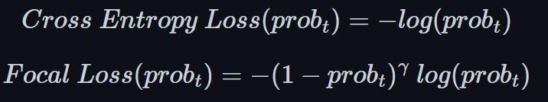
Class Imbalance
Technique | Description
Downsampling | Reducing samples of majority class Not suited for this dataset (|Training Samples| = ~33k)
Upsampling | Replicating minority class samples. 2 * |Effective Samples| + 3 * |Ineffective Samples| + |Adequate Samples|
Focal Loss [1708.02002] Focal Loss for Dense Object Detection (arxiv.org) | Addresses class imbalance during training. Applies a modulating term to Cross-Entropy loss to focus on hard misclassified examples. (Gamma = 2)
Weighted Sampling & Loss Function | Weighted mini-batch sampling. Weighted Cross-Entropy loss function [Effective: 3.93 / 1.5, Adequate: 1.75 / 1, Ineffective:5.69 / 2]

Slide 11
Feature Engineering

Slide 12
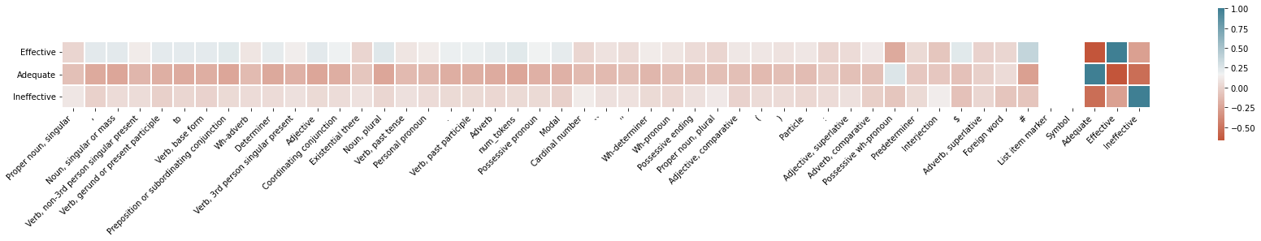
Feature Engineering: Part of speech
Part of Speech p |Corr(p, Ineffective)|
Proper_Nouns 0.216405
misspelled_count 0.139763
Cardinal number 0.127971
Noun, Plural 0.121559
Existential There 0.074274
... ...
Notes:
The grading rubric, and dataset samples, indicate that identifying parts of speech counts may serve as a useful feature. Parts of speech are also known as lexical categories or word classes. For example, the rubric includes guidance that, “a statistic, a quotation,” supports an effective rating for the Lead element. A statistic, in many cases, can be recognized by identification of one or more ‘cardinal’ parts of speech - a number in digit or written form.
Similarly, quotations in the discourse element can be identified by the count of quotation symbols. We observe in the training set coordinating conjunctions such as and, but, neither, and or appear in Cf6 However, with discourse elements averaging 28 distinct words, many of the token tags are underrepresented. To mitigate, we can combine or drop tokens of the same type to capture the feature, for example all representations of single and double quotes can be collapsed to a ‘Contains Quotation’ feature.
There is a pen on the desk

Slide 13
Not-In-Vocabulary Count
Misspelled words are not penalized while grading Discourse elements.
Subword Tokenizers in Large Language models - Out of Vocabulary and Misspelled Words.
Correlation between the count of misspelled words in discourse text and effectiveness
Effectiveness Class | Effective | Adequate | Ineffective
Mean (Not in Vocabulary Words) | 0.59 | 0.78 | 1.42
Dictionary/Vocabulary is built from NLTK word corpora (words, brown and wordnet)
|Vocabulary| - 346,423

Slide 14
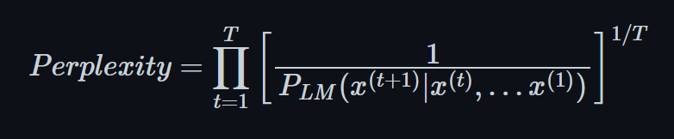
Text Perplexity GPT-2
Pre-trained Language Models are trained on Clean Corpora. The standard evaluation metric is perplexity:
The lower the perplexity, the more probable (natural) the sentence is.
We are using the Generative Pre-trained Transformer model (GPT2) to compute the perplexity score of the discourse text, and the normalized perplexity score is used as a feature.
Effectiveness Class | Effective | Adequate | Ineffective
Mean (Perplexity Score) | 157.58 | 240.87 | 297.66
Median (Perplexity Score) | 46.10 | 79.86 | 87.28
Standard Deviation (Perplexity Score) | 1357.04 | 1569.65 | 1858.54

Slide 15
Model Architecture

Slide 16
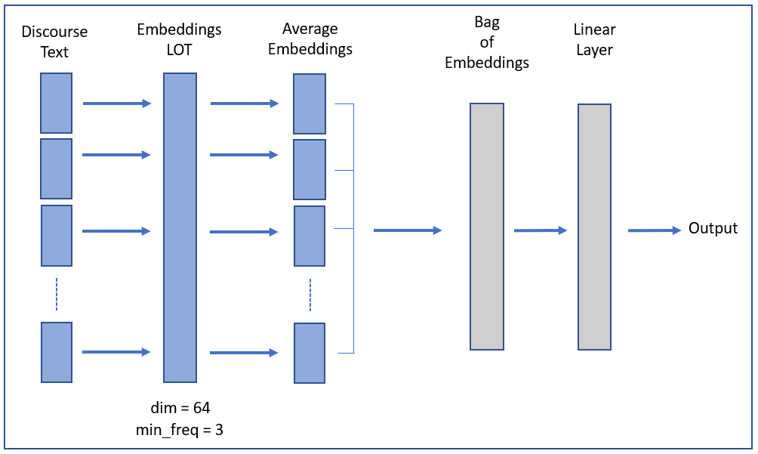
Bag of Embeddings
EPOCHS = 10
LEARNING RATE = 5
BATCH SIZE = 64
EMBEDDING SIZE = 64

Slide 17
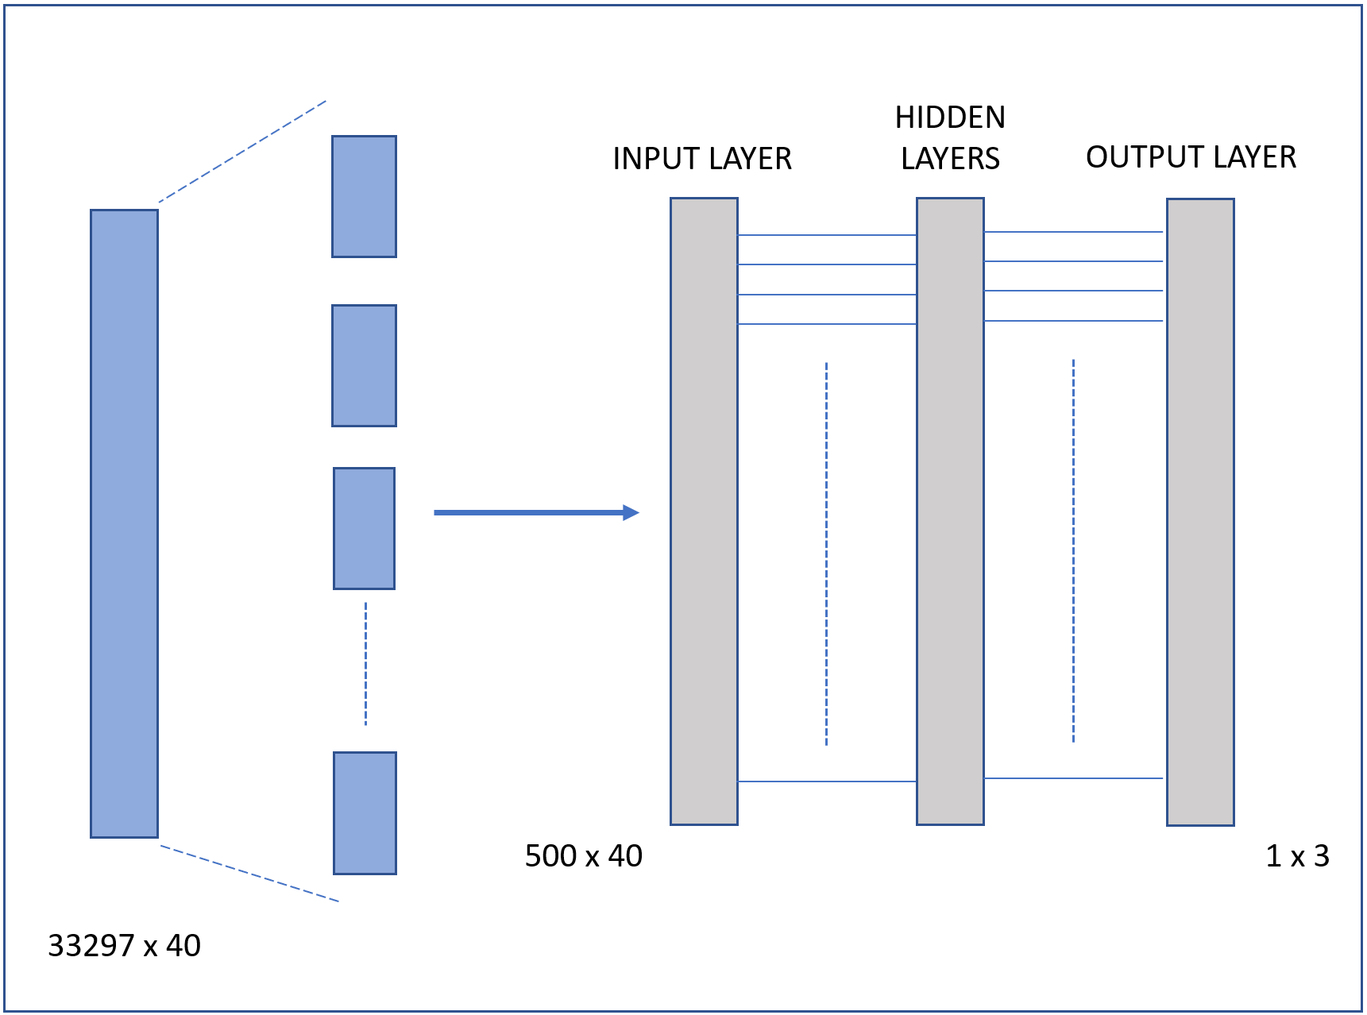
Feed Forward Neural Network
INPUT SIZE = 40
EPOCHS = 10
LEARNING RATE = 0.001
BATCH SIZE = 500
HIDDEN SIZE = 200

Slide 18
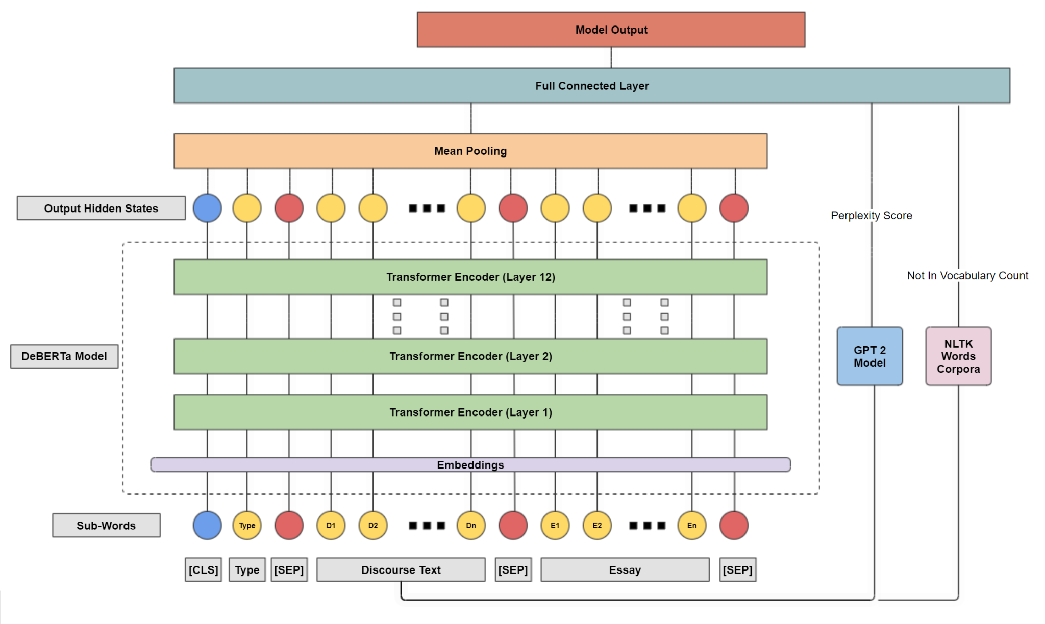
Augmented DeBERTa Network

Slide 19
Experiment Details & Hyperparameters (Best Model)
Component / Hyperparameter | Description
Input Representation | The input text for the DeBERTa tokenizer is the concatenation of "Discourse Type", " Discourse Text", and "Argumentative Essay" separated by special tokens (start token: [CLS], separator token: [SEP]).
Input Text Length | Max token length is set to 1024, which ensures that the complete discourse text and type for all samples are represented, and a portion of the essay is covered.
DeBERTa Representation | Output hidden states for each sub-word is fed to the Mean Pooling layer, which computes the final representation considering the Mask values.
Feed Forward Input | Input to the Feed Forward Network consisted of representation from the DeBERTa model and augmented features of normalized GPT-2 Perplexity score and Not-In-Vocabulary count using NLTK word corpora.
#Hidden Units in Feed Forward Layer | 128
Optimizer | AdamW
Scheduler | Linear Scheduler with Warmup (500 steps)
Loss Function | Cross Entropy Loss
Batch Size | 4
#Epochs | 5
Learning Rate | 3e-6
Dropout | 0.10
Weight Decay / L2 Regularization | 0.005

Slide 20
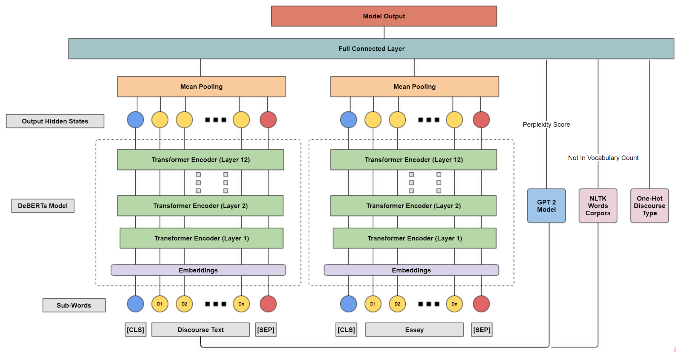
Augmented 2-DeBERTa Network

Slide 21
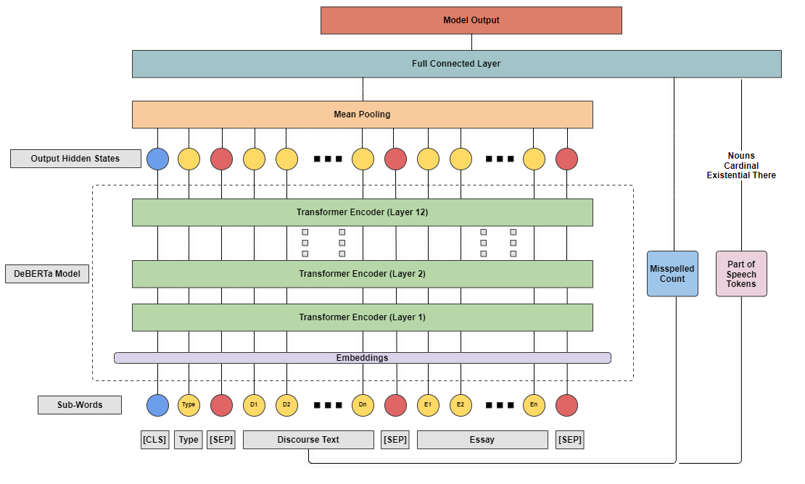
Adam
Augmented 2-DeBERTa Network with PoS Counts
Deberta + mean pooling + misspelling
Notes:
Dropout. 0.05,
DeBERTa-v3 5 184.02M 4hours 31mins 0.66 62.98% 70%
out = self.model(input_ids=ids,attention_mask=mask,
output_hidden_states=False)
out = self.mpool(out.last_hidden_state, mask)
out = self.drop(out)
out = self.fc(out)
out = self.drop(out)
misspelled_count = misspelled_count.view(-1,1)
merged_output = torch.cat((out, misspelled_count), dim=1)
out = self.fc2(merged_output)

Slide 22
Results
Description | Parameters | Training Time | Log Loss | Balanced Accuracy | Test Accuracy
Bag of Embeddings [Input: Discourse Text, Embedding size: 64] | 620K | 50.5 sec | 3.390 | - | 61.0%
Neural Network [Input: Features (POS) , Hidden layer: 200] | 8.8k | 4.7 sec | 0.823 | - | 63.5%
BERT[Input: Discourse Text, BERT Hidden Layers: 6] | 66.95M | 2 hours 50 mins | 0.777 | 56.38% | 66.70%
RoBERTa [Input: Discourse Text, Essay, RoBERTa Hidden Layers: 8, Features: Not-In-Vocabulary, Discourse Type, 2 RoBERTa models] | 193.38M | 5 hours 35 mins | 0.741 | 59.22% | 68.80%
RoBERTa [Input: Discourse Text, Essay, RoBERTa Hidden Layers: 6, Features: Not-In-Vocabulary, Discourse Type, 2 RoBERTa models, Weighted Loss] | 164.63M | 4 hours 10 mins | 0.741 | 62.61% | 65.66%
DeBERTa-v3 [Input: Discourse Text, Essay, DeBERTa Hidden Layers: 12, Features: Not-In-Vocabulary, Discourse Type, 2 DeBERTa models, Focal Loss] | 367.66M | 10 hours 35 mins | 0.681 | 59.93% | 69.98%
DeBERTa-v3 [Input: Discourse Type, Discourse Text, Essay, DeBERTA Hidden Layers: 12, Features: misspelled count] | 184.03M | 6 hours 3 mins | 0.657 | 64.63% | 70.6%
DeBERTa-v3 [Input: Discourse Type, Discourse Text, Essay, DeBERTA Hidden Layers: 12, Features: misspelled count, cardinal numbers, proper nouns, and existential there.] | 184.02M | 4 hours 31 mins | 0.660 | 62.98% | 70.0%
DeBERTa-v3 [Input: Discourse Text, Essay, DeBERTa Hidden Layers: 12, Features: Not-In-Vocabulary, Discourse Type, GPT-2 Perplexity Score] | 183.93M | 10 hours 30 mins | 0.660 | 63.05% | 71.11%

Slide 23
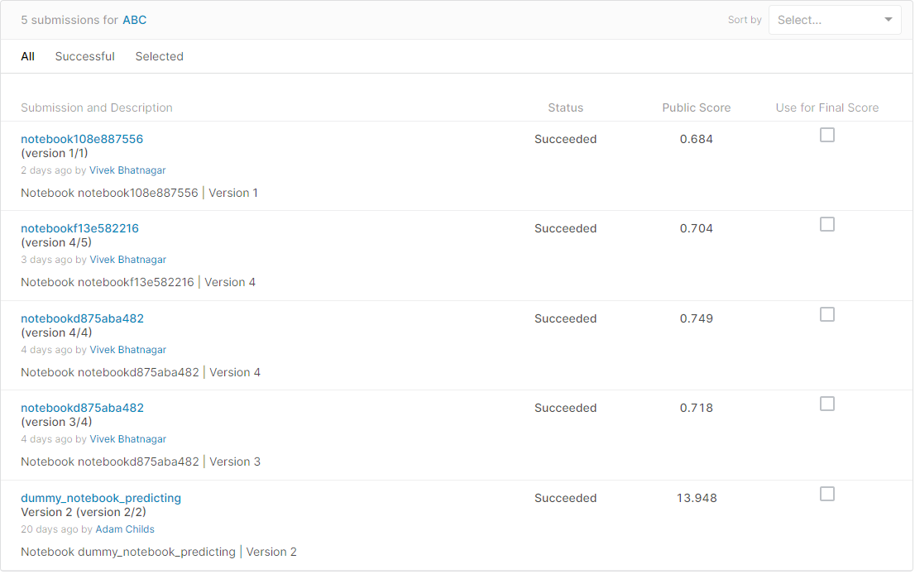
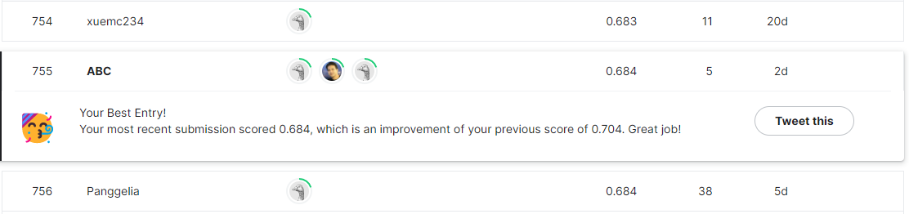
Kaggle Submissions

Slide 24
Conclusions
Prediction with unconstrained content and qualitative labels is non-trivial
Domain Experts help when Feature Engineering
Teams: Parallel model development and verification
Abandon features when they aren’t helping
Ensemble models can improve accuracy

Slide 25
References
Feedback Prize - Predicting Effective Arguments | Kaggle. Kaggle.com. Published 2022. Accessed July 12, 2022. https://www.kaggle.com/competitions/feedback-prize-effectiveness/data‌.
argumentation_scheme_and_rubrics_kaggle.docx. argumentation_scheme_and_rubrics_kaggle.docx. Google Docs. Published 2022. Accessed July 12, 2022. https://docs.google.com/document/d/1G51Ulb0i-nKCRQSs4p4ujauy4wjAJOae/edit

